Slide 1


Introduction to Political Risk Specifics
Cash Management Matters
Dr. Barbara S. Ismail
EVP, CMM
Beirut, 4/29-5/1/13

Slide 2
The Take-Away
Introduction to Political Risk Specifics
Cash Management Matters
1) Market Drivers
2) Triggers
3) Parties
4) Transaction Boundaries
5) Dynamics
Defining the specific risks involved
  How are they covered
  Wording and Exceptions
  Coverage and Policies
The parties involved: Insured, Insurer, Reinsurer
  Information Capture
  Managing relationships
  Managing risks
  Covering risks: country, exporter, reinsurance
  Managing treaty risk
Triggers
  Occurrence of events
  Actions to be taken
  Covering your coverage: ensuring you can claim under your policy

Slide 3
Why Political Risk Insurance?
Introduction to Political Risk Specifics
Cash Management Matters
1) Market Drivers
2) Triggers
3) Parties
4) Transaction Boundaries
5) Dynamics
Export flows globally increasing and growing more complex in terms of both industry and geography
Historically, flows have been primarily short term, but larger projects and heavier capital flows are becoming more frequent
Supply chain management has evolved, and is now more dependent upon ‘just in time’ supply and manufacturing, making disruption a tangible risk and working capital challenges

Slide 4
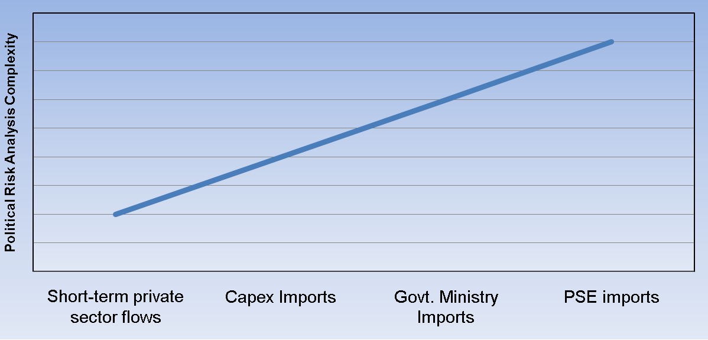
Why Political Risk Insurance? (continued)
Introduction to Political Risk Specifics
Cash Management Matters
1) Market Drivers
2) Triggers
3) Parties
4) Transaction Boundaries
5) Dynamics

Slide 5
Political Risk
Introduction to Political Risk Specifics
Cash Management Matters
1) Market Drivers
2) Triggers
3) Parties
4) Transaction Boundaries
5) Dynamics
The definition of political risk and specific perils is still evolving
Rise in recent political, social, economic and financial instability in both emerged and emerging markets

Slide 6
What Triggers Political Risk Events?
Introduction to Political Risk Specifics
Cash Management Matters
2) Triggers
1) Market Drivers
3) Parties
4) Transaction Boundaries
5) Dynamics
The actions, inactions and/or default, of a Supra-National Authority, or Government Entity, including the inability to make a currency conversion and/or exchange transfer or sanctions. Such actions may also include default of a Government Entity which is guaranteeing the performance of either another Government Entity or of a Commercial Organisation.
In the case of Civil Insurrection or Terrorism, any group or individual, government or non-government, which creates chaos and instability resulting in an inability to continue business activity or payments

Slide 7
Parties
Introduction to Political Risk Specifics
Cash Management Matters
3) Parties
1) Market Drivers
2) Triggers
4) Transaction Boundaries
5) Dynamics
Supra-National Authority
A multi-national (also known as a “multilateral”) institution (e.g. the IDB, United Nations, the International Monetary Fund or the European Union) which has a ruling body whose controlling interest is held by government ministers, or formally appointed representatives, of member states.

Slide 8
Parties continued
Introduction to Political Risk Specifics
Cash Management Matters
3) Parties
1) Market Drivers
2) Triggers
4) Transaction Boundaries
5) Dynamics
Government Entity
    (i) a Central Government or a Ministry, Department or Agency thereof (hereinafter referred to as “Government”);
    (ii) a Regional or Local Authority or a Department or Agency thereof (hereinafter referred to as “Local Authority”);
    (iii) a Nationalised Undertaking, including a Public Corporation or a State Trading Organisation or an entity in which the Government of the country(ies) concerned or Local Authority(ies) retain(s) a controlling interest or a majority shareholding; or
    (iv) a central bank or other equivalent monetary authority.

Slide 9
Parties continued
Introduction to Political Risk Specifics
Cash Management Matters
3) Parties
1) Market Drivers
2) Triggers
4) Transaction Boundaries
5) Dynamics
Commercial Organisation
Limited companies, public limited companies, partnerships, and sole traders, which may include banks or financial institutions, but none of the foregoing may include a Government Entity
People creating Unrest, disruption etc.
Very difficult to identify, define or monitor

Slide 10
Parties continued
Introduction to Political Risk Specifics
Cash Management Matters
3) Parties
1) Market Drivers
2) Triggers
4) Transaction Boundaries
5) Dynamics
TAKING ON RISK:
ECA writing policies to protect exports
PUTTING OFF RISK:
Reinsurers participating in one off or treaties covering the book of business written by ECA

Slide 11
Parties continued
Introduction to Political Risk Specifics
Cash Management Matters
3) Parties
1) Market Drivers
2) Triggers
4) Transaction Boundaries
5) Dynamics
ECA Managing ongoing relationship with treaty reinsurers
Understanding Reinsurance Treaties: structure, requirements, agreement
Reinsurance Broker searches for market capacity
Reinsurance Treaties structured with several levels of risk and deductibles
Reinsurers examine books and agree to take on risk

Slide 12
Transaction Boundaries: Specificity is Your Friend
Introduction to Political Risk Specifics
4) Transaction Boundaries
Cash Management Matters
1) Market Drivers
2) Triggers
3) Parties
5) Dynamics
Transaction boundaries- must be clearly trade specific given variables and uncertainties
a specified contract or contracts for the sale, purchase, lease or delivery of assets, goods or services; or
an agreement which relates directly to the financing of such specified contract(s); or
an agreement concerning financing which is secured against assets, goods or services and/or payment for assets, goods or services due under a specified contract or contracts, or where repayment is to be effected by the sale or receipts of such goods or services, or assets, royalties or other specified receivables; or
a Bond or Bonds provided in accordance with the terms of a specified contract, tender document or project
A letter of credit to be confirmed by banks against policies

Slide 13
Outline of Risks
Introduction to Political Risk Specifics
Cash Management Matters
4) Transaction Boundaries
1) Market Drivers
2) Triggers
3) Parties
5) Dynamics
Confiscation, Expropriation, Nationalization (CEN)
  Capital intensive, non-liquid large projects
  ‘‘Bricks and Mortar / natural resources”
  Situations of Political Upheaval and Uncertainty: coup, government overthrow, military takeover, civil war Triggered by unambiguous government action (in this context similar to, but not the same as, terrorism)
  Includes breach of contract

Slide 14
CEN continued
Introduction to Political Risk Specifics
Cash Management Matters
4) Transaction Boundaries
1) Market Drivers
2) Triggers
3) Parties
5) Dynamics
Loss of physical assets
Loss of control of assets: project, plant, mine, engineering, etc.
  Disincentive for company to move investment after physical plant is completed
  ‘creeping expropriation’ in joint ventures, change of regulatory environment
  Contract disputes, arbitration
Loss of Capital / Investment / In-Country Accounts (e.g. Bank Nationalization)

Slide 15
CEN continued
Introduction to Political Risk Specifics
Cash Management Matters
4) Transaction Boundaries
1) Market Drivers
2) Triggers
3) Parties
5) Dynamics
Often least expensive to ensure
Least ambiguous of named perils
Most often paid
One off policies for specific projects/businesses
May require the insured to walk away from the asset, ceding it to the insurer

Slide 16
Transfer Risk (Inconvertibility)
Introduction to Political Risk Specifics
Cash Management Matters
4) Transaction Boundaries
1) Market Drivers
2) Triggers
3) Parties
5) Dynamics
The government ordered cessation of transfer of foreign currency (‘hard currency’)
Closing of the foreign exchange window
Inability of local importers to undertake international payments in any currency other than local

Slide 17
Transfer Risk continued
Introduction to Political Risk Specifics
Cash Management Matters
4) Transaction Boundaries
1) Market Drivers
2) Triggers
3) Parties
5) Dynamics
Payment due in a currency not controlled by the payor nation (Euro?)
Must be formally ordered by the local government
Foreign currency payment must be approved by local government
  ‘creeping expropriation’ restricting capital flows and switching payment to (devalued) local currency

Slide 18
Transfer Risk continued
Introduction to Political Risk Specifics
Cash Management Matters
4) Transaction Boundaries
1) Market Drivers
2) Triggers
3) Parties
5) Dynamics
Claim can be clouded by unclear reason for delay in payment
No official government decree
Transfer Risk or Credit Risk for private company?
  Often company must prove it has sufficient local currency available to make payment in foreign currency

Slide 19
Transfer Risk continued
Introduction to Political Risk Specifics
Cash Management Matters
4) Transaction Boundaries
1) Market Drivers
2) Triggers
3) Parties
5) Dynamics
Often a blurred line between transfer and credit default becomes a problem for exporters claiming/ECAs paying out under these
Consider the wording of perils to clarify as far as possible where one ends and the other begins

Slide 20
Comprehensive Risk
Introduction to Political Risk Specifics
Cash Management Matters
4) Transaction Boundaries
1) Market Drivers
2) Triggers
3) Parties
5) Dynamics
Non payment for any reason: transfer or credit
Particularly important for government or quasi-government payors
  Blurred line between government agencies who cannot pay or choose not to
  Comprehensive risk subsumes credit risk

Slide 21
Comprehensive Risk continued
Introduction to Political Risk Specifics
Cash Management Matters
4) Transaction Boundaries
1) Market Drivers
2) Triggers
3) Parties
5) Dynamics
If Government Payors are not insured under comprehensive risk policies, claims become extremely difficult
Most expensive of risks to insure, because easiest to claim with widest coverage
Caveat: Agencies of government which are not 100% owned by government should still be covered under a Comprehensive Policy

Slide 22
Wrongful Calling on Demand Contract Guarantees / Bonds
Introduction to Political Risk Specifics
Cash Management Matters
4) Transaction Boundaries
1) Market Drivers
2) Triggers
3) Parties
5) Dynamics
Bid Bonds
Advance or Stage Payment Bonds
Performance Bonds
Warranty
  On Demand by Beneficiary
  Bank or Insurance Company has no choice but to pay upon demand

Slide 23
Wrongful Calling continued
Introduction to Political Risk Specifics
Cash Management Matters
4) Transaction Boundaries
1) Market Drivers
2) Triggers
3) Parties
5) Dynamics
Called by beneficiary with no contractual reason
Called for non performance, when such non performance is caused by the withdrawal of import/export license, embargo or political violence
Refusal to accept/pay negotiate documents under L/Cs on pretext of spurious discrepancies (this can be difficult to prove without specific access to documents)

Slide 24
Political Violence
Introduction to Political Risk Specifics
Cash Management Matters
4) Transaction Boundaries
1) Market Drivers
2) Triggers
3) Parties
5) Dynamics
War, terrorism, political unrest or public chaos which prevents a company from conducting business
Shutdown of civil society
“SRCC” strikes, riots, civil commotion
Sabotage and Terrorism
Full political violence
NB: the unrest must continue for long enough to constitute a real impediment to business. Should it disappear during the waiting period dictated in all policies, claims will be rejected
Premiums currently range from 25 bp to 300 bp

Slide 25
Contract Frustration
Introduction to Political Risk Specifics
Cash Management Matters
4) Transaction Boundaries
1) Market Drivers
2) Triggers
3) Parties
5) Dynamics
Customer’s bankruptcy or default
Contract cancellation
Payment delays caused by blocked funds or transfer difficulties
Hostilities in the country of export
Cancellation of export or import permits
Moratorium on debt

Slide 26
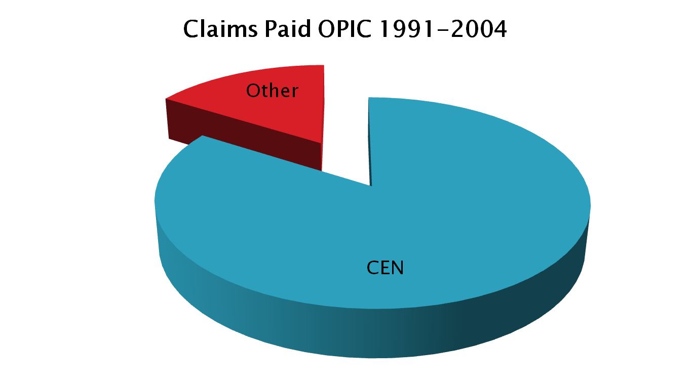
Claims Paid OPIC 1991 - 2004
Introduction to Political Risk Specifics
Cash Management Matters
5) Dynamics
1) Market Drivers
2) Triggers
3) Parties
4) Transaction Boundaries
Jensen, Managing Risk Insurance Premiums

Slide 27
Introduction to Political Risk Specifics
Cash Management Matters
5) Dynamics
1) Market Drivers
2) Triggers
3) Parties
4) Transaction Boundaries
Examples of Transfer Risk Premiums 12/2011 (Height of Greek Crisis)
Greece | 84.00%
Italy | 4.36%
Portugal | 10.30%
Spain | 3.31%
Brazil | 1.12%
Russia | 2.32%
China | 0.99%

Slide 28
Country Risk Perceptions
Introduction to Political Risk Specifics
Cash Management Matters
5) Dynamics
1) Market Drivers
2) Triggers
3) Parties
4) Transaction Boundaries
Shifting Global Risk Perceptions: Q3 2012
 | - Points difference in ECR scores -
 | Quarterly change | 2012 (Q1 – Q3) | Two year change
North America | -0.7 | -1.2 | -5.8
G-10 | -0.6 | -1.4 | -7.3
Eurozone | -0.5 | -2.3 | -10.6
CEE (ex CIS) | -0.3 | -1.6 | -7.4
European Union | -0.3 | -1.7 | -8.9
CIS | -0.1 | -0.3 | -3.8
Brics | 0.0 | -1.3 | -10.1
Latin America | 0.0 | -0.4 | -6.4
Africa | 0.0 | -0.4 | -2.1
Middle East | 0.3 | -0.6 | -10.0
Asia (ex CIS) | 0.4 | 0.0 | -4.2
Australasia | 0.8 | 0.9 | 2.2
Caribbean | 1.0 | 1.1 | 3.1
Note: minus sign indicates increased risk
Source: Euromoney Country Risk

Slide 29
Trade Risk Experience: Members
Introduction to Political Risk Specifics
Cash Management Matters
5) Dynamics
1) Market Drivers
2) Triggers
3) Parties
4) Transaction Boundaries
Loss ratio | 2010 |  |  | 2011
 | claims | premium | loss ratio | claims | premium | loss ratio
COTUNACE | 2.91 | 3.98 | 0.73 | 2.33 | 3.41 | 0.68
CAGEX | 0.4 | 3.9 | 0.10 | 4.5 | 4.71 | 0.96
JLGC | 0.14 | 0.2 | 0.70 | 0 | 0.28 | 0.00
ASEI | 1.1 | 8.9 | 0.12 | 0.78 | 11.4 | 0.07
ICIEC | 0 | 13.9 | 0.00 | 0 | 14.2 | 0.00
EGFI | 3.91 | 55.25 | 0.07 | 14.5 | 12.76 | 1.14
LCI | 0.36 | 4.09 | 0.09 | 0.97 | 5.08 | 0.19
Shiekan | 0.015 | 0.96 | 0.02 | 0.064 | 0.73 | 0.09
ECGE | 0.04 | 1.03 | 0.04 | 0.03 | 0.66 | 0.05
Turk Eximbank | 13.9 | 18.57 | 0.75 | 7.2 | 20.5 | 0.35
NAIFE | 0 | 0.04 | 0.00 | 0.76 | 0.06 | 12.67
MEXIM | 0.72 | 4.23 | 0.17 | 3.15 | 7.01 | 0.45
DHAMAN | 0.04 | 8.8 | 0.00 | 0.14 | 4.73 | 0.03
SEP | 0.13 | 1.44 | 0.09 | 0.66 | 0.97 | 0.68
ECIE | 0 | 0.06 | 0.00 | 0.1 | 0.6 | 0.17
ECGA | 0.01 | 1.63 | 0.01 | 0.002 | 1.32 | 0.00
SONAC | 0 | 0.27 | 0.00 | 0 | 0.31 | 0.00
Total | 23.68 | 127.25 | 0.19 | 35.19 | 88.73 | 0.40
Am an Union 2011 Performance Report Extract (USD million)

Slide 30
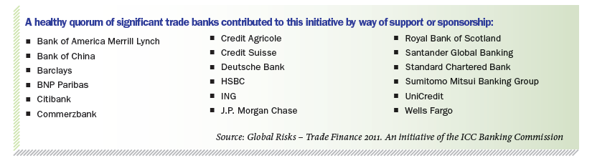
Trade Risk Experience: Banks
Introduction to Political Risk Specifics
Cash Management Matters
5) Dynamics
1) Market Drivers
2) Triggers
3) Parties
4) Transaction Boundaries
ICC Trade Register Findings

